Slide 1
DIVACTORY 01 Warm Up Case
Oleh : Bismillah
Mohammad Alfan A. R.
Doni Rubiagatra
Taufik Kurniawan
Eza Putra Nuansa

Slide 2
Outline
Deskripsi Variabel
Eksplorasi Data
Building Model
Hasil
Kesimpulan

Slide 3
Deskripsi Data

Slide 4
Deskripsi Data
Data yang digunakan terdiri dari 22 variabel dimana 21 variabel bersifat kontinu dan 1 variabel bersifat kategorik.
21 variabel kontinu adalah variabel Peubah 1 s.d. Peubah 21. Sedanglan variabel kategorik adalah variabel Target.

Slide 5
Eksplorasi Data

Slide 6
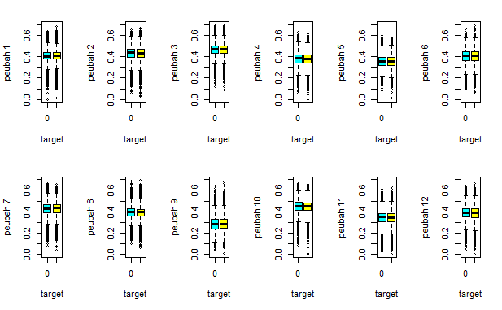
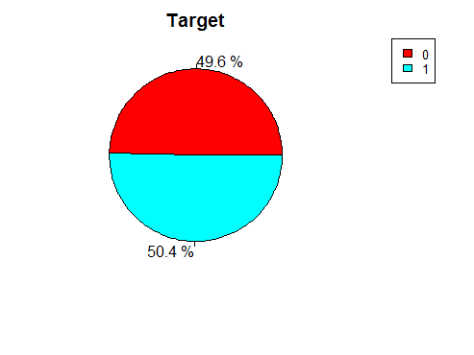
Eksplorasi Data

Slide 7
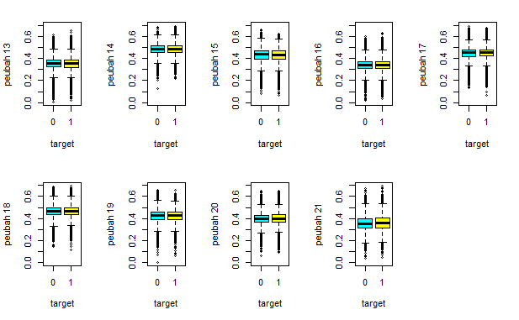
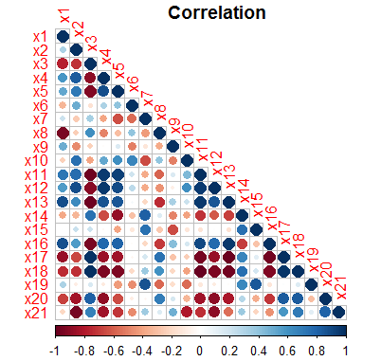
Eksplorasi Data

Slide 8
Building Model

Slide 9
Building Model
Algoritma yang digunakan untuk membangun model
Naïve Bayes Clasifier
Logistic Regression
Random Forest
Decision Tree
Support Vector Machine
Setiap model dievaluasi dengan k-fold cross validation dengan fold sebanyak 10 dan dengan menggunakan kriteria meminimumkan loss log function

Slide 10
Building Model
Skenario Model
Data
Full Model
Dimensional Reduction
Model (PCA)
Evaluation

Slide 11

Building Model
Software dan Package yang digunakan
Stats (logistic regression)
randomForest (random forest)
caret (k fold CV)
e1071 (SVM and NBC)
Tree (Decision Tree)
MLmetrics (Log Loss Function)

Slide 12
Hasil
Full Model : Menggunakan seluruh variabel prediktor (feature)
k-Fold | NBC | Logistic Regression | Random Forest | Decision Tree | SVM
1 | 0.7030 | 0.6913 | 0.7136 | 0.6932 | 0.6921
2 | 0.7333 | 0.6932 | 0.7187 | 0.6930 | 0.6945
3 | 0.7110 | 0.6920 | 0.7174 | 0.6934 | 0.6930
4 | 0.7200 | 0.6917 | 0.7140 | 0.6931 | 0.6924
5 | 0.7131 | 0.6923 | 0.6981 | 0.6930 | 0.6924
6 | 0.7160 | 0.6943 | 0.7158 | 0.6931 | 0.6929
7 | 0.7091 | 0.6932 | 0.7158 | 0.6931 | 0.6936
8 | 0.7216 | 0.6913 | 0.7190 | 0.6931 | 0.6930
9 | 0.7219 | 0.6907 | 0.7249 | 0.6931 | 0.6923
10 | 0.7146 | 0.6932 | 0.7096 | 0.6934 | 0.6927
Rata-Rata | 0.7164 | 0.6923 | 0.7147 | 0.6931 | 0.6929

Slide 13
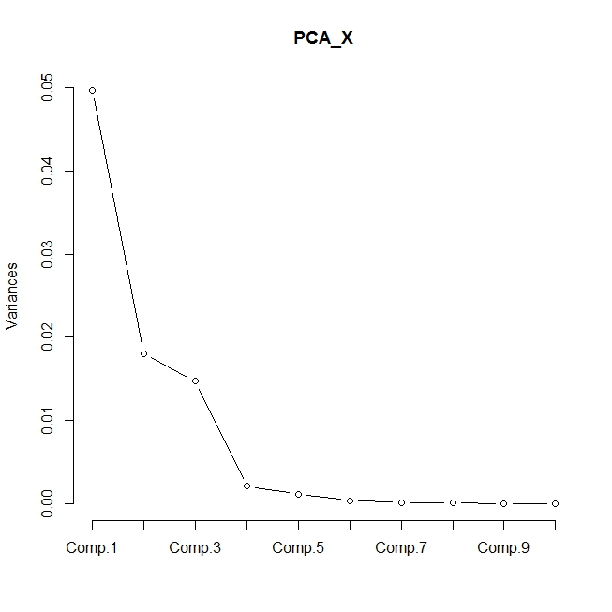
Hasil
Dimensional Reduction Model : Menggunakan pengurangan dimensi dengan Principal Component Analysis
Importance of components:
 | Comp.1 | Comp.2 | Comp.3 | Comp.4 | Comp.5
Standard deviation | 0.222926 | 0.134361 | 0.121364 | 0.045825 | 0.033967
Proportion of Variance | 0.575071 | 0.208905 | 0.170443 | 0.0243 | 0.013351
Cumulative Proportion | 0.575071 | 0.783976 | 0.954419 | 0.978718 | 0.992069
3 Komponen yang digunakan

Slide 14
Building Model
Dimensional Reduction Model (cont.)
k-Fold | NBC | Logistic Regression | Random Forest | Decision Tree | SVM
1 | 0.6917 | 0.6919 | 0.7301 | 0.6932 | 0.6926
2 | 0.6939 | 0.6939 | 0.7380 | 0.6930 | 0.6938
3 | 0.6930 | 0.6931 | 0.7412 | 0.6934 | 0.6931
4 | 0.6923 | 0.6925 | 0.7393 | 0.6931 | 0.6930
5 | 0.6918 | 0.6922 | 0.7277 | 0.6930 | 0.6926
6 | 0.6929 | 0.6924 | 0.7399 | 0.6931 | 0.6929
7 | 0.6931 | 0.6932 | 0.7325 | 0.6931 | 0.6931
8 | 0.6929 | 0.6927 | 0.7419 | 0.6931 | 0.6932
9 | 0.6927 | 0.6923 | 0.7377 | 0.6931 | 0.6924
10 | 0.6932 | 0.6931 | 0.7332 | 0.6934 | 0.6935
Rata-Rata | 0.6928 | 0.6927 | 0.7362 | 0.6931 | 0.6930

Slide 15
Kesimpulan

Slide 16
Kesimpulan
Model | NBC | Logistic Regression | Random Forest | Decision Tree | SVM
Full Model | 0.7164 | 0.6923 | 0.7147 | 0.6931 | 0.6929
PCA Model | 0.6928 | 0.6927 | 0.7362 | 0.6931 | 0.6930
Model yang diaplikasikan adalah berbasis PCA dikarenakan hasil full model dan PCA tidak terlalu menghasilkan perbedaan yang cukup signifikan. Juga tentunya model yang menggunakan variabel lebih sedikit memerlukan komputasi yang lebih singkat.

Slide 17
Terima Kasih

